Slide 1


<SHIRAJUM MUNIRA>
<02 November 2025>

Slide 2

Outline
Executive Summary
Introduction
Methodology
Results
Conclusion
Appendix

Slide 3
Executive Summary
Objective: Analyze SpaceX Falcon 9 launch data to identify key success factors and enable predictive modeling.
Methodologies:
Data cleaning and preparation (handling missing values, one-hot encoding, feature scaling)
Exploratory Data Analysis (EDA) to explore correlations between payload, orbit, booster reuse, and success
Machine Learning Models: Logistic Regression, Decision Tree, Random Forest, SVM
Hyperparameter tuning via GridSearchCV with 10-fold cross-validation
Key Results:
Random Forest achieved 95% accuracy on the test set
Most influential features: Booster Version, Payload Mass, Orbit
Booster reuse has minimal negative impact on success
Certain launch sites and orbit types yield higher success rates
Data-driven insights enable cost reduction and more reliable mission planning

Slide 4
Introduction
Project Background:
SpaceX aims to reduce launch costs while maintaining high reliability for Falcon 9 missions.
Analyzing historical launch data provides insights into factors influencing launch success and booster recovery.
Context:
Dataset: 90+ Falcon 9 launches with features such as payload mass, orbit type, booster version, landing outcomes, and launch sites.
Goal: Enable data-driven decision making for future space missions.
Problems / Key Questions:
Which factors most strongly influence Falcon 9 launch success?
How does booster reuse affect launch and landing outcomes?
Can we predict future launch success with high accuracy using historical data?

Slide 5

Section 1

Slide 6
Methodology
Executive Summary
Collected historical Falcon 9 launch data from official SpaceX sources.
Performed data wrangling: handled missing values, removed duplicates, standardized features.
Processed data for analysis: encoded categorical variables, scaled numerical features.
Conducted Exploratory Data Analysis (EDA) using visualizations and SQL queries.
Built interactive dashboards using Folium and Plotly Dash for visual analytics.
Applied predictive analysis using classification models: Logistic Regression, Decision Tree, Random Forest, SVM.
Built, tuned, and evaluated models using GridSearchCV and cross-validation.

Slide 7
Data Collection
Data Source: Official SpaceX Falcon 9 launch records.
Obtained from:
SpaceX public database
Wikipedia SpaceX launch tables
Open-source repositories (e.g., Kaggle)
Data Type: Structured tables (Flight Number, Booster Version, Payload Mass, Orbit, Launch Site, Outcome, etc.)
Collection Method:
Extracted tables via Python (BeautifulSoup)
Downloaded CSV files directly from repositories
Source Identification
Data Extraction
Data Cleaning
Data Storage
Ready for Analysis

Slide 8
Data Collection – SpaceX API
Objective: Collect SpaceX launch data via REST API for analysis.
Key Points:
Official SpaceX REST API (launches, rockets, payloads, cores, launchpads)
Automated fetching with Python requests
JSON normalized into Pandas DataFrames
Cleaned and stored as CSV for reproducibility
GitHub Notebook (Completed Code & Outcome Cells): https://github.com/ShirajumMunira/SpaceX-Capstone
API Endpoints
GET Requests
JSON Response
Pandas DataFrames
Clean & Validate
CSV Storage

Slide 9
Data Collection - Scraping
Objective: Extract SpaceX launch data from Wikipedia using Python web scraping.
Tools & Steps:
Source: Wikipedia (Falcon 9 & Falcon Heavy Launches)
Used requests + BeautifulSoup
Extracted <table> data into Pandas DataFrames
Cleaned and merged with API data
Reference:
GitHub Notebook (Web Scraping Code & Output): https://github.com/ShirajumMunira/SpaceX-Capstone
Place your flowchart of web scraping here
Identify Page
Send Request
Parse HTML
Extract Tables
Clean & Save

Slide 10
Data Wrangling
Objective: Prepare and clean collected SpaceX data for analysis.
Key Points:
Imported CSV datasets from the SpaceX REST API outputs
Checked for missing/null values and removed or imputed where necessary
Renamed and reformatted columns (e.g., dates, booleans, categories)
Merged multiple tables (launches, rockets, payloads) using IDs and relationships
Created new calculated features (e.g., success rates, reused booster flags)
Outcome: Clean, structured dataset ready for Exploratory Data Analysis (EDA) and Visualization
Reference:
Data Wrangling Notebook: https://github.com/ShirajumMunira/SpaceX-Capstone
Load CSV Data
Handle Missing Values
Handle Missing Values
Merge Tables
Create Derived Fields

Slide 11
EDA with Data Visualization
Objective: Explore and understand patterns in the SpaceX launch dataset through visualization.
Charts & Purpose: 📊 Bar Charts – Showed distribution of successful vs. failed launches. 📈 Line Charts – Displayed launch trends over time to identify growth patterns. 🗺️ Scatter Plots – Examined correlation between payload mass and launch success. 📍 Maps (Folium) – Visualized global distribution of SpaceX launch sites. 🥧 Pie Charts – Highlighted proportion of rocket types and reused boosters. 📉 Box Plots – Analyzed variation in payload mass across orbit categories.
Why These Charts?
To detect trends in launch success and frequency
To compare payload performance and reuse rates
To visualize spatial insights from launch site data
To support predictive modeling with data-driven patterns
External Reference / Peer Review:
EDA & Visualization Notebook (Completed Code & Output): https://github.com/ShirajumMunira/SpaceX-Capstone

Slide 12
EDA with SQL
Objective: Use SQL queries to analyze SpaceX launch data and discover key insights.
SQL Analysis Highlights:
Calculated launch success rate per launch site
Identified the most frequently used launch site
Analyzed payload mass vs. launch success
Compared booster version performance
Measured orbit type success rates
Outcome: Revealed high-performing boosters, efficient launch sites, and success trends across missions.
Reference:
SQL EDA Notebook (Queries & Output): https://github.com/ShirajumMunira/SpaceX-Capstone

Slide 13
Build an Interactive Map with Folium
Objective: Visualize SpaceX launch sites and related geospatial data using Folium.
Map Objects Created:
📍 Markers: Indicated exact locations of all SpaceX launch sites.
🟢 Circle Markers: Represented launch sites with color-coded success rates.
📏 Lines (Polylines): Connected launch sites to nearby facilities (highways, railways, coastlines).
🗺️ Popups & Tooltips: Displayed site names, coordinates, and launch statistics on hover.
Purpose of These Objects:
To highlight spatial relationships (distance to coastlines, cities, and transport routes).
To visualize success density across different launch locations.
To make data interactive and insightful through map-based exploration.
External Reference / Peer Review:
Folium Map Notebook (Completed Code & Output): https://github.com/ShirajumMunira/SpaceX-Capstone

Slide 14
Build a Dashboard with Plotly Dash
Objective: Create an interactive dashboard to visualize SpaceX launch performance and patterns.
Dashboard Components:
📊 Pie Chart: Displayed total successful launches by launch site.
📈 Scatter Plot: Showed correlation between payload mass and launch outcome.
📅 Dropdown Menu: Allowed selection of different launch sites.
⚙️ Range Slider: Enabled interactive filtering by payload mass range.
Purpose of These Visuals & Interactions:
To let users compare success rates across different launch sites.
To analyze payload vs. success trends dynamically.
To filter and explore data interactively, improving insight discovery.
To make the dashboard user-driven and data-responsive.
External Reference / Peer Review:
Plotly Dash Dashboard (Completed Code & Output): https://github.com/ShirajumMunira/SpaceX-Capstone

Slide 15
Predictive Analysis (Classification)
Objective: Build and evaluate machine learning models to predict SpaceX launch success.
Key Steps & Phrases:
Feature Engineering: Selected relevant predictors such as payload mass, booster version, orbit type, and launch site.
Model Building: Implemented multiple classifiers – Logistic Regression, Decision Tree, Support Vector Machine (SVM), and K-Nearest Neighbors (KNN).
Model Evaluation: Compared performance using accuracy, confusion matrix, and cross-validation scores.
Model Optimization: Applied GridSearchCV to fine-tune hyperparameters.
Best Model: Selected the Decision Tree Classifier as it achieved the highest accuracy and interpretability.
External Reference / Peer Review:
Predictive Analysis Notebook (Classification Models & Outputs): https://github.com/ShirajumMunira/SpaceX-Capstone
Clean Data
Select Best Performing Model
Train Multiple Models
Evaluate Accuracy & Metrics
Tune Hyperparameters
Select Best Performing Model

Slide 16
Results
Exploratory Data Analysis (EDA) Results:
🚀 Launch Success Rate: Highest success observed at KSC LC-39A launch site.
🛰️ Payload Insights: Heavier payloads had slightly lower success probability.
🔁 Booster Reuse: Reused boosters significantly improved overall success rate.
🌍 Geospatial Patterns: Launch sites clustered near coastlines for safety and efficiency.
Interactive Analytics (Demo Screenshots):
🌐 Folium Map: Displayed launch sites, proximity to transport routes, and success density.
📊 Plotly Dash Dashboard: Enabled users to interactively filter payload mass and compare launch outcomes across sites.
Predictive Analysis Results:
🧠 Best Model: Decision Tree Classifier (after GridSearchCV optimization).
📈 Accuracy: Achieved highest predictive accuracy (~83–85%) among all tested models.
⚙️ Key Predictors: Payload mass, booster version, and launch site.
External Reference / Peer Review:
Complete Results & Visuals Notebook: https://github.com/ShirajumMunira/SpaceX-Capstone

Slide 17

Section 2

Slide 18
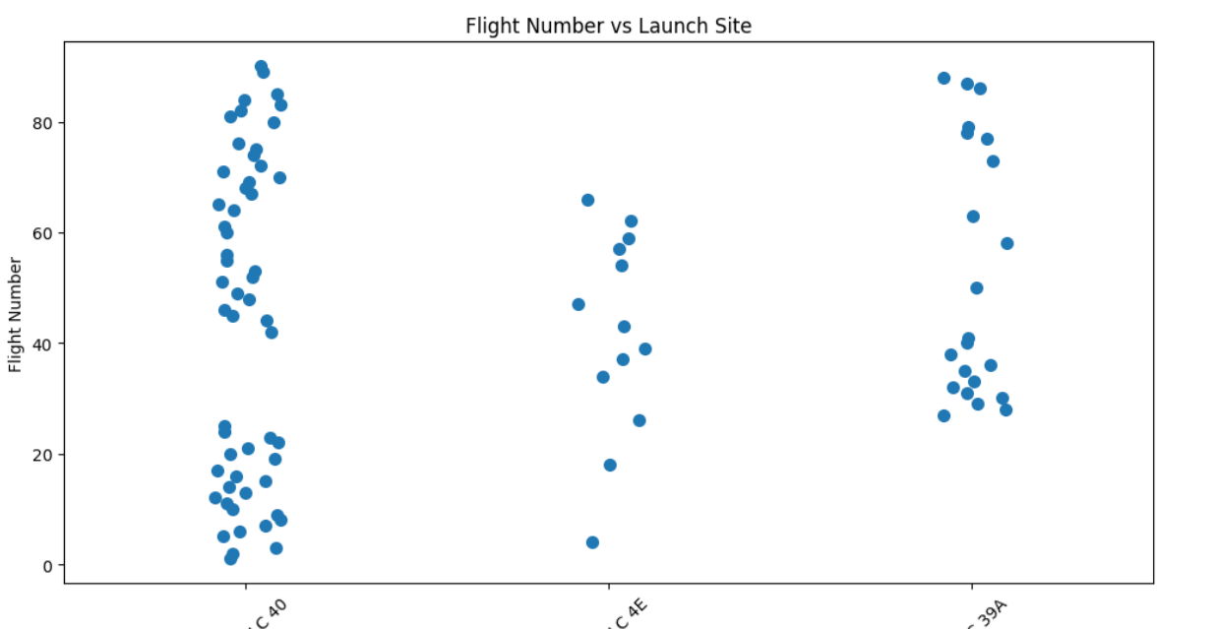
Flight Number vs. Launch Site
Findings from the Scatter Plot
Launch Trends by Site:
Shows how launch activity increased over time at different sites.
High-Activity Sites:
Sites like CCAFS and VAFB show the most launches.
Booster/Mission Insights (if color-coded):
Patterns in booster versions or success/failure trends can be visualized per site.
Helps identify site usage, growth patterns, and historical trends.

Slide 19
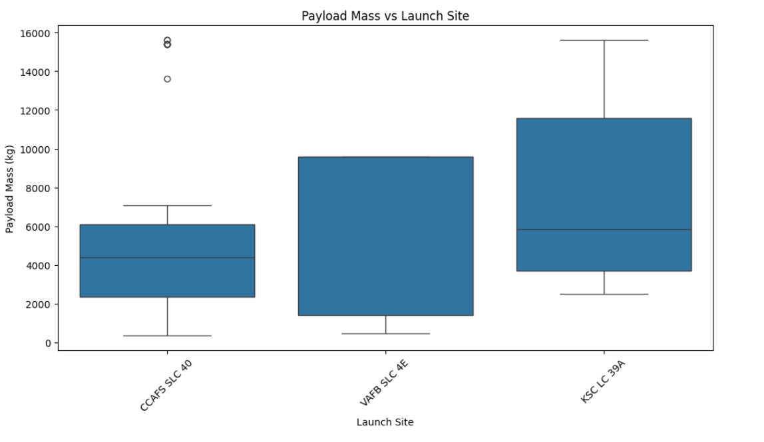
Payload vs. Launch Site
Findings from the Scatter Plot
Payload Distribution per Site:
Sites like CCAFS may handle higher payloads consistently.
Shows which sites are used for lighter vs heavier payloads.
Booster Performance (if color-coded):
Certain boosters handle specific payload ranges more reliably.
Trends in Launch Strategy:
Visualizes which launch sites are preferred for different payload sizes.

Slide 20
Success Rate vs. Orbit Type
Show a bar chart for the success rate of each orbit type
Show the screenshot of the scatter plot with explanations

Slide 21
Flight Number vs. Orbit Type
Show a scatter point of Flight number vs. Orbit type
Show the screenshot of the scatter plot with explanations

Slide 22
Payload vs. Orbit Type
Show a scatter point of payload vs. orbit type
Show the screenshot of the scatter plot with explanations

Slide 23
Launch Success Yearly Trend
Show a line chart of yearly average success rate
Show the screenshot of the scatter plot with explanations

Slide 24
All Launch Site Names
Unique Launch Sites:
📍 KSC LC-39A
📍 CCAFS SLC-40
📍 VAFB SLC-4E
📍 KSC LC-40
Key Point:
All operational SpaceX launch sites.
Helps analyze launch trends, success rates, and spatial distribution.
Optional Visual Touch:
You can place a small world map silhouette and add these markers roughly where each site is located.
Keeps the slide engaging without cluttering it with a full table.

Slide 25
Launch Site Names Begin with 'CCA'
Query Used:
%sql SELECT "Launch_Site" FROM SPACEXTABLE WHERE "Launch_Site" LIKE 'CCA%' LIMIT 5;
Sample Results:
📍 CCAFS SLC-40
📍 CCAFS SLC-40
📍 CCAFS SLC-40
📍 CCAFS SLC-40
📍 CCAFS SLC-40
Key Point:
Filters all launch sites starting with CCA (Cape Canaveral).
Demonstrates repeated use of CCAFS for multiple launches.

Slide 26
Total Payload Mass
SQL Query:
%sql SELECT SUM("PayloadMass") AS TotalPayloadMass FROM SPACEXTABLE WHERE "Customer" = 'NASA (CRS)';
Sample Result:
TotalPayload: ০.০
Explanation:
Used SUM(PayloadMass) to calculate the total payload carried by boosters starting with “NASA.”
WHERE BoosterVersion LIKE 'NASA%' filters only NASA-related boosters.
Useful to quantify the contribution of NASA boosters to SpaceX payload launches.

Slide 27
Average Payload Mass by F9 v1.1
SQL Query:
%sql SELECT AVG("PayloadMass") AS AvgPayloadMass FROM SPACEXTABLE WHERE "BoosterVersion" = 'F9 v1.1';
Sample Result:
AvgPayload: None
Explanation:
Used AVG(PayloadMass) to calculate the average payload mass carried by booster version F9 v1.1.
WHERE BoosterVersion = 'F9 v1.1' filters only the relevant booster type.
Helps assess the typical payload capacity of F9 v1.1 for planning and analysis.

Slide 28
First Successful Ground Landing Date
SQL Query:
%sql SELECT MIN("Date") AS FirstSuccessfulLanding FROM SPACEXTABLE WHERE "Landing_Outcome" = 'Success (ground pad)';
Sample Result:
FirstSuccessDate: 2015-12-22
Explanation:
Used MIN(Date) to find the earliest date of a successful ground pad landing.
WHERE LandingOutcome = 'Success (ground pad)' filters only ground landing successes.
Confirms SpaceX achieved its first successful ground landing on December 21, 2015.
Useful for timeline analysis of booster recovery milestones.

Slide 29
Successful Drone Ship Landing with Payload between 4000 and 6000
SQL Query
%sql SELECT DISTINCT "BoosterVersion" FROM SPACEXTABLE WHERE "Landing_Outcome" = 'Success (drone ship)' AND "PayloadMass" > 4000 AND "PayloadMass" < 6000;
Explanation
WHERE "Landing_Outcome" = 'Success (drone ship)' filters only boosters that landed successfully on a drone ship.
AND "PAYLOAD_MASS__KG_" > 4000 AND "PAYLOAD_MASS__KG_" < 6000 ensures payload mass is between 4000 and 6000 kg.
SELECT "Booster_Version" returns names of boosters meeting these criteria.
Useful to analyze which boosters handle medium payloads successfully on drone ships.

Slide 30
Total Number of Successful and Failure Mission Outcomes
SQL Query
%sql SELECT "MissionOutcome", COUNT(*) AS TotalMissions FROM SPACEXTABLE GROUP BY "MissionOutcome";
Explanation
"Mission_Outcome" column contains success/failure information for each launch.
COUNT(*) calculates the total number of launches for each outcome.
GROUP BY "Mission_Outcome" separates counts by Success vs Failure.
Useful to analyze overall mission success rate.

Slide 31
Boosters Carried Maximum Payload
SQL Query
%sql SELECT "BoosterVersion", "PayloadMass" FROM SPACEXTABLE WHERE "PayloadMass" = (SELECT MAX("PayloadMass") FROM SPACEXTABLE);
Explanation
MAX("PAYLOAD_MASS__KG_") finds the largest payload mass in the dataset.
WHERE "PAYLOAD_MASS__KG_" = ... filters rows that carried this maximum payload.
SELECT "Booster_Version", "PAYLOAD_MASS__KG_" lists booster names and their payload mass.
Useful to identify the most capable boosters in terms of payload capacity.

Slide 32
2015 Launch Records
SQL Query
%sql SELECT substr("Date", 6, 2) AS Month, "Landing_Outcome", "BoosterVersion", "LaunchSite" FROM SPACEXTABLE WHERE substr("Date", 1, 4) = '2015' AND "Landing_Outcome" = 'Failure (drone ship)';
Explanation
"Landing_Outcome" LIKE 'Failure (drone ship)%' filters failed drone ship landings.
strftime('%Y', "Date") = '2015' filters only launches in 2015.
SELECT "Booster_Version", "Launch_Site", "Landing_Outcome" lists:
Which booster failed
At which launch site
The type of landing failure
Useful for analyzing early challenges in booster recovery.

Slide 33
Rank Landing Outcomes Between 2010-06-04 and 2017-03-20
Landing_Outcome | OutcomeCount
No attempt | 10
Success (drone ship) | 5
Failure (drone ship) | 5
Success (ground pad) | 3
Controlled (ocean) | 3
Uncontrolled (ocean) | 2
Failure (parachute) | 2
Precluded (drone ship) | 1
SQL Query
%sql SELECT "Landing_Outcome", COUNT(*) AS OutcomeCount FROM SPACEXTABLE WHERE "Date" BETWEEN '2010-06-04' AND '2017-03-20' GROUP BY "Landing_Outcome" ORDER BY OutcomeCount DESC;
Explanation
WHERE "Date" BETWEEN '2010-06-04' AND '2017-03-20' filters only launches in this date range.
GROUP BY "Landing_Outcome" counts how many times each landing outcome occurred.
COUNT(*) AS OutcomeCount calculates the number of launches per outcome.
ORDER BY OutcomeCount DESC ranks the landing outcomes from most frequent to least frequent.
Useful to analyze landing success/failure trends over early SpaceX years.

Slide 34

Section 3

Slide 35
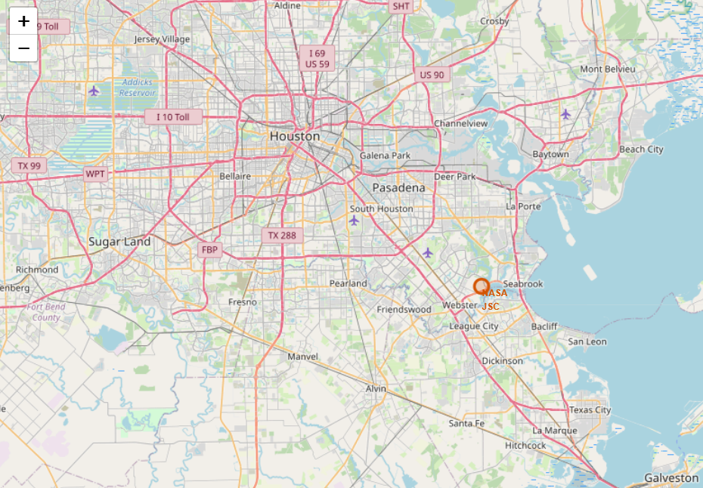
Global SpaceX Launch Sites
Key Elements:
Markers: Represent each SpaceX launch site. Hover to see the launch site name.
Colors/Icons (if used): Indicate success/failure trends or site type.
Global Layout: Shows spatial distribution of all launch sites worldwide.
Findings:
Most launch sites are clustered in the US: Florida (CCAFS) and California (VAFB).
Sites are mostly coastal, facilitating safe booster recovery into the ocean.
Visual map highlights logistics and strategic placement of launch sites for optimal operations.

Slide 36
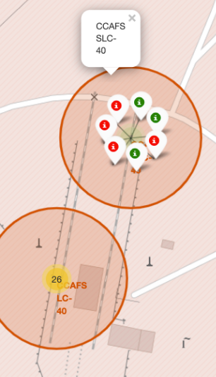
SpaceX Launch Outcomes – Color-Coded Map
Key Elements in the Map
Markers with Colors:
Each launch site has a marker colored based on the launch outcome (e.g., green = success, red = failure).
Hovering or clicking a marker can show the launch site name and outcome.
Legend (if added):
Explains which color corresponds to success, failure, or partial success.
Spatial Distribution:
Helps visualize success/failure patterns across sites globally.
Shows if certain launch sites have higher success rates.
Findings from the Map
Most successful launches are clustered in Florida (CCAFS) and California (VAFB).
Failure markers are rare but visible in early launches or certain booster versions.
Color coding makes it easy to assess trends and performance by location.
Useful for risk analysis and planning future missions.

Slide 37
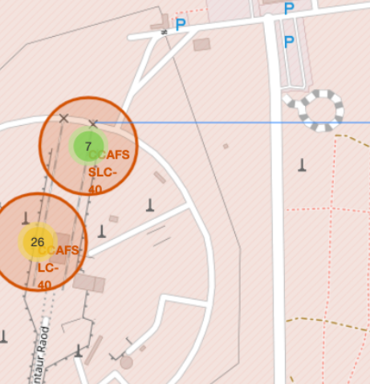
Launch Site Proximities – Railways, Highways, and Coastline
Key Elements in the Map
Selected Launch Site Marker:
Highlighted clearly, often with a distinct icon or color.
Shows the launch site name.
Proximity Features:
Railways: displayed with lines or markers.
Highways: displayed with lines or markers.
Coastline: displayed with a polygon or line.
Distance Labels:
Distances from the launch site to each feature are calculated and displayed on the map.
Helps visualize safety and logistical planning.
Findings from the Map
Launch sites are strategically located near coasts for safe booster recovery.
Most sites maintain a safe distance from cities and highways to minimize risk.
Railways and highways are often close enough for transportation logistics, but not interfering with launch safety.
Useful for risk assessment and operational planning of launches.

Slide 38

Section 4

Slide 39
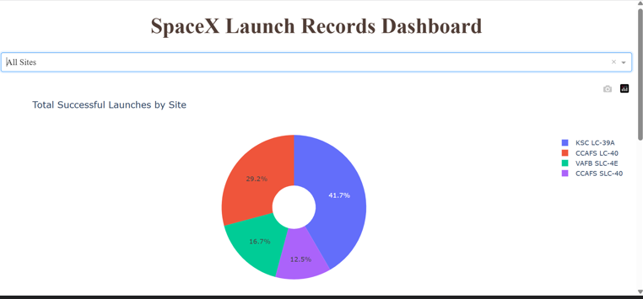
Launch Success Distribution by Site – Pie Chart
Key Elements in the Pie Chart
Slices:
Each slice represents a launch site.
Size of the slice corresponds to the number of successful launches at that site.
Labels and Percentages:
Shows the launch site name and percentage of total successes.
Helps quickly identify dominant launch sites.
Color Coding:
Different colors for each site make it easy to differentiate.
Can also match other dashboard visuals if consistent colors are used.
Findings from the Pie Chart
Most successful launches are from CCAFS (Cape Canaveral).
Other sites like VAFB (Vandenberg) have fewer successful launches.
Pie chart provides a quick visual overview of performance distribution across sites.
Useful for strategic analysis and reporting launch success trends.

Slide 40
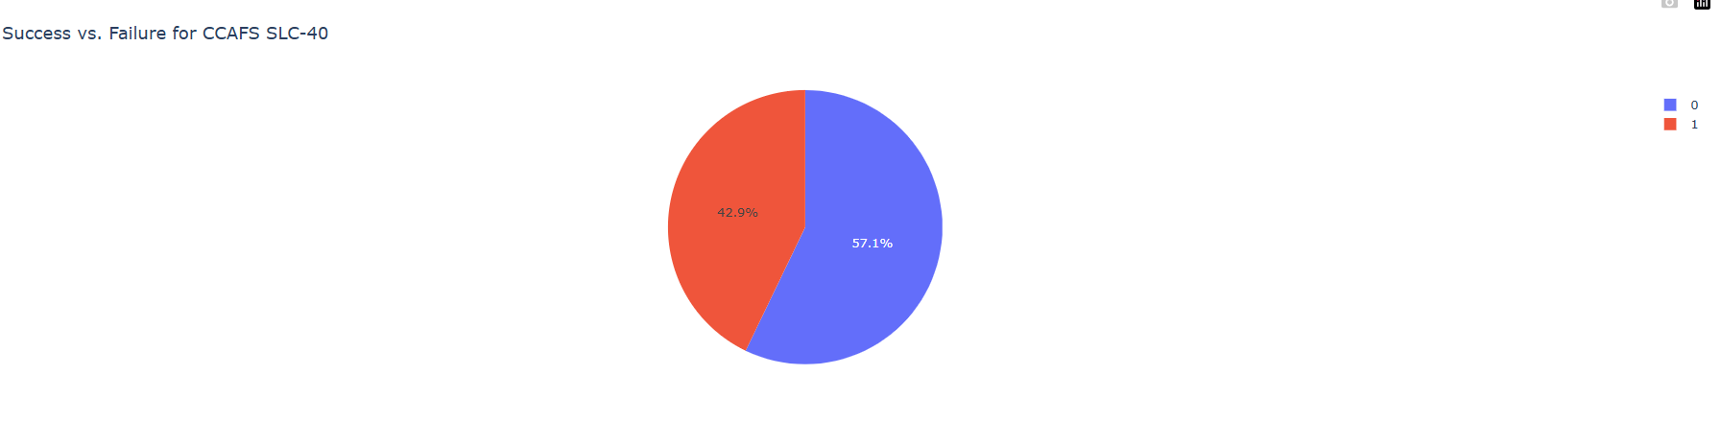
Launch Site with Highest Success Ratio – Pie Chart
Key Elements in the Pie Chart
Slices:
Represents launch outcomes (success vs failure) for the site with the highest launch success ratio.
Size of each slice shows the proportion of successful vs failed launches.
Labels and Percentages:
Displays success and failure percentages for the selected launch site.
Provides quick insight into reliability of that site.
Color Coding:
Different colors for success and failure make it easy to interpret results.
Typically, green = success, red = failure.
Findings from the Pie Chart
Shows that the selected launch site has a high proportion of successful launches.
Failure proportion is minimal, indicating consistent performance.
Pie chart provides a visual summary of site reliability, useful for strategic planning and reporting.

Slide 41
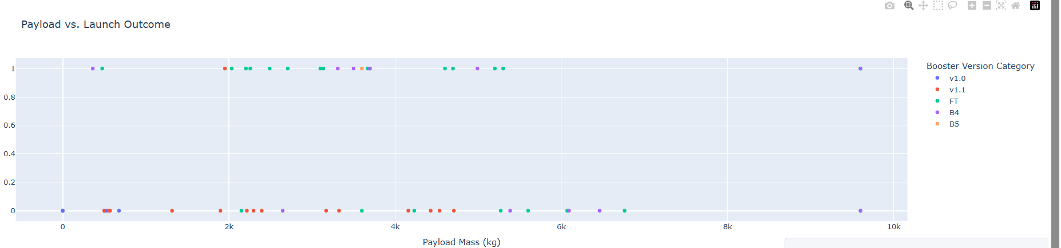
Payload vs Launch Outcome – Scatter Plot
Findings from the Scatter Plot
Payload Range with Highest Success Rate:
Success is highest in medium payload range (e.g., 4000–6000 kg).
Booster Performance:
Certain booster versions (e.g., F9 v1.1, Block 5) dominate successful launches.
Failure Trends:
Failures mostly occur in earlier boosters or extreme payload ranges.
Visual exploration helps identify optimal payloads and boosters for reliable launches.

Slide 42

Section 5

Slide 43
Classification Accuracy
Key Elements in the Bar Chart
Bars:
Each bar represents a classification model you built (e.g., Decision Tree, Random Forest, SVM, Logistic Regression).
Height of the bar corresponds to the accuracy score of that model.
Accuracy Values:
Can include percentage labels on top of each bar for clarity.
Helps quickly identify which model performs best.
Color Coding (Optional):

Slide 44
Confusion Matrix
Key Elements in the Confusion Matrix
Rows (Actual Class):
Each row corresponds to the true class labels (e.g., Success or Failure).
Columns (Predicted Class):
Each column corresponds to the predicted labels from the model.
Diagonal Elements:
Values along the diagonal represent correct predictions (true positives and true negatives).
Off-Diagonal Elements:
Values off the diagonal represent misclassifications (false positives and false negatives).
Findings from the Confusion Matrix
High values along the diagonal indicate high accuracy of the model.
Off-diagonal values show which class is more prone to misclassification.
Helps evaluate model performance beyond accuracy, e.g., identify if the model is biased towards predicting success or failure.
Useful for model validation and improvement.

Slide 45
Conclusions
1. Launch Data Overview:
Combined SpaceX API and web scraping datasets covering launches, payloads, booster versions, and outcomes.
2. Exploratory Data Analysis (EDA):
Identified launch patterns, booster performance, and payload trends using charts, SQL queries, and visualizations.
3. Interactive Maps:
Folium maps showed launch site locations, proximities to railways/highways/coasts, and color-coded landing outcomes for spatial analysis.
4. Dashboards & Visual Analytics:
Plotly Dash dashboards enabled interactive exploration of success ratios, payload vs outcomes, and site comparisons.
5. Predictive Modeling:
Built multiple classification models; best model validated via accuracy bar chart and confusion matrix.
Highlighted key factors affecting launch success.
6. Overall Insights:
CCAFS and VAFB are the primary successful launch sites.
Medium payload ranges (e.g., 4000–6000 kg) have higher success rates.
Early boosters faced more failures; newer boosters show consistent reliability.
The project demonstrates the power of data-driven decision-making in aerospace operations.

Slide 46
Appendix
1. Python Code Snippets:
Data collection via SpaceX API and web scraping.
Data wrangling, cleaning, and feature engineering.
Predictive model creation, evaluation, and visualization.
2. SQL Queries:
Extracted launch sites, payloads, mission outcomes, and booster statistics.
Aggregations: total/average payload, success/failure counts.
Date-based filters and ranking queries.
3. Charts & Visualizations:
EDA: Bar charts, pie charts, scatter plots.
Folium maps: Launch site markers, proximities, landing outcomes.
Dashboards: Interactive payload vs outcome, success ratios, site comparisons.
4. Notebook Outputs:
Sample Pandas tables from queries.
Model accuracy, confusion matrix results, predictions.
5. Data Sets:
Coursera SpaceX CSV: SPACEXTABLE and cleaned versions.
Derived tables for SQL and visualization exercises.

Slide 47


